Slide 1
Collective Intelligence Path Planning
Gergely Magyar
dexfd3@inf.elte.hu

Slide 2
Multi Agent Path Planning
Task
multiple Agents
Target locations
static Obstacles
Agents must travel to a specific point in space while avoiding collisions
Unique Target per Agent
Goal
Train Agents that can
Reach Target location
Avoid colliding with other Agents and Obstacles

Slide 3
Environment
Specifications
2D environment with borders
3 different Entities represented as circles
Agent
Obstacle
Target
Agents can go in 4 directions
Agents and Obstacles can collide with each other
Entities get nudged in opposite direction
Implementation
Gym
PettingZoo
Custom, based on MPE environments

Slide 4
Observation space
Infinite range
Relative positions
XY coordinates
Possible observations
Position of Target
Position of Agent
relative from middle (0, 0)
Position of N closest Agents or Obstacles
Next position of close Agent
current position + velocity
Observation space size not dependent on number of Agents!

Slide 5
Rewards
2 components
Distance from Target
Euclidean distance
Logarithm of distance
Penalty from collisions
Static number
No global reward
2 phases of the project
Make Agent reach the goal
Only distance-based reward
2 Agents
Avoid collisions
Distance based reward
Collision penalty
Variable Agent count

Slide 6
Models and Policies
Chosen policy
Proximal Policy Optimization
Fast convergence
Some experience already
Model
Simple MLP
No hidden layers
1 Hidden layer
No hidden layers
Hyperparameters
Learning rate: 0.0001
Entropy coefficient: 0.001
n_steps: 1024
n_epochs: 2
batch_size: max 2 batches (~4000)
env_count: 8
steps_per_env: 512
4 updates per update cycle
~8000 steps of data before update
Can be tweaked more

Slide 7
Evaluation metrics
Average over all timesteps
Distance from Target
Euclidian
Standing on Target
Collision with another Agent
Collision with Obstacle
Agent and Obstacle separate
Agent number is changing
Obstacle stays same
Reward is shaped, not comparable
2 phases of the project
Make Agent reach the goal
Distance
Avoid collisions
Distance
Collisions

Slide 8
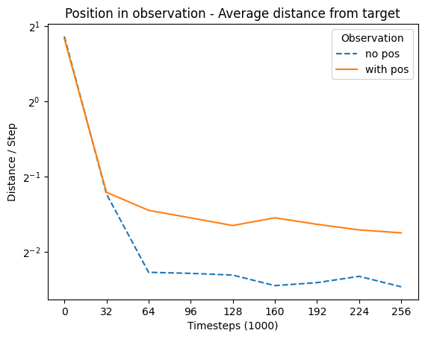
Phase 1 Results (1/4)
Largest difference – Position in Observation

Slide 9
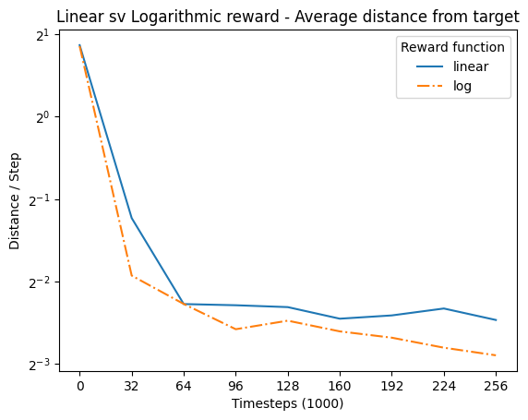
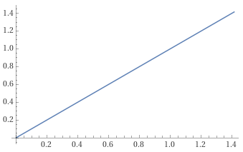
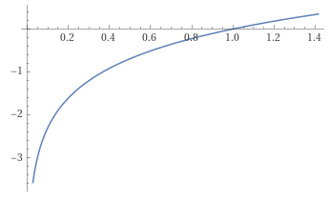
Phase 1 Results (2/4)
Logarithm of distance
Linear
Logarithmic

Slide 10
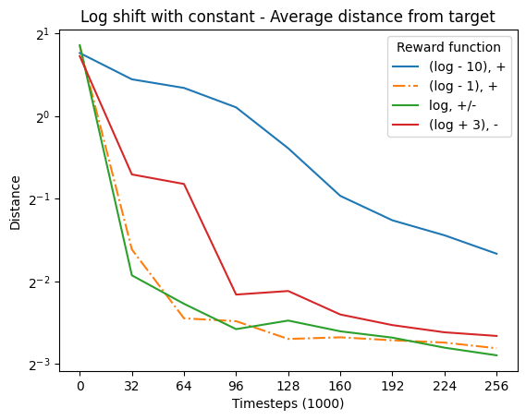
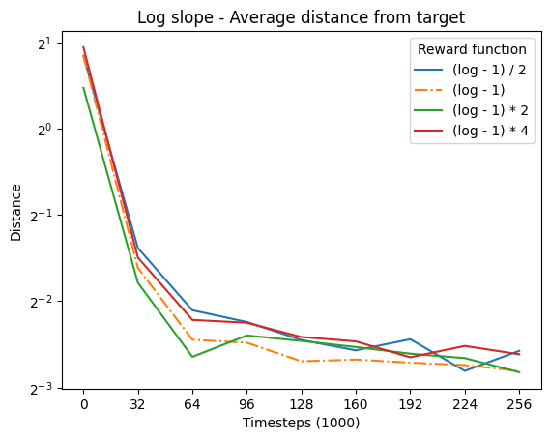
Phase 1 Results (3/4)
Logarithm of distance

Slide 11
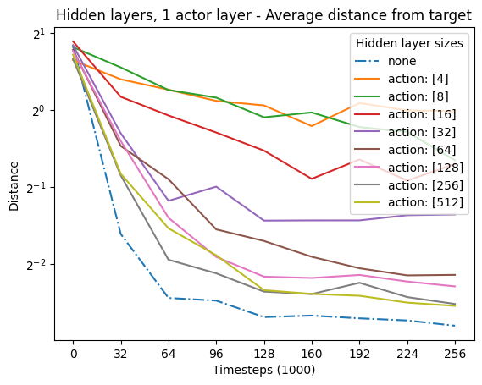
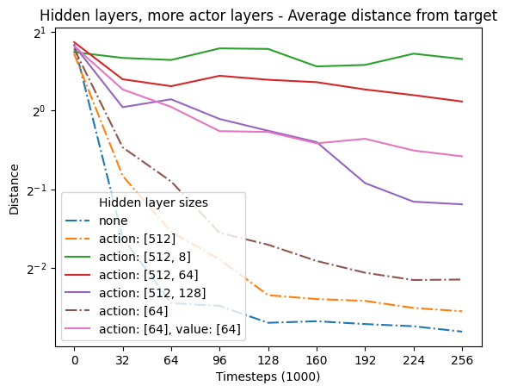
Phase 1 Results (4/4)
Neural Network

Slide 12
Agent examples
Step 32k
Step 64k
Step 128k
Step 160k
Step 192k
Step 224k

Slide 13
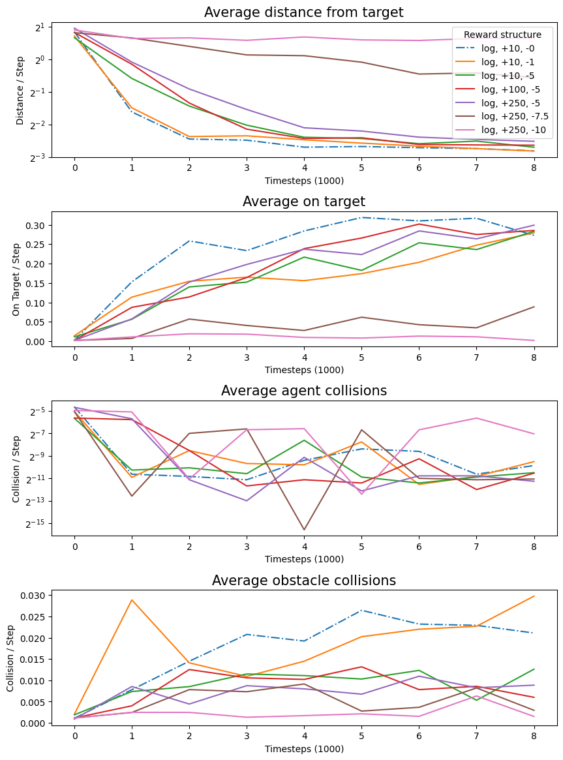
Phase 2 Results (1/4)
Reward structure

Slide 14
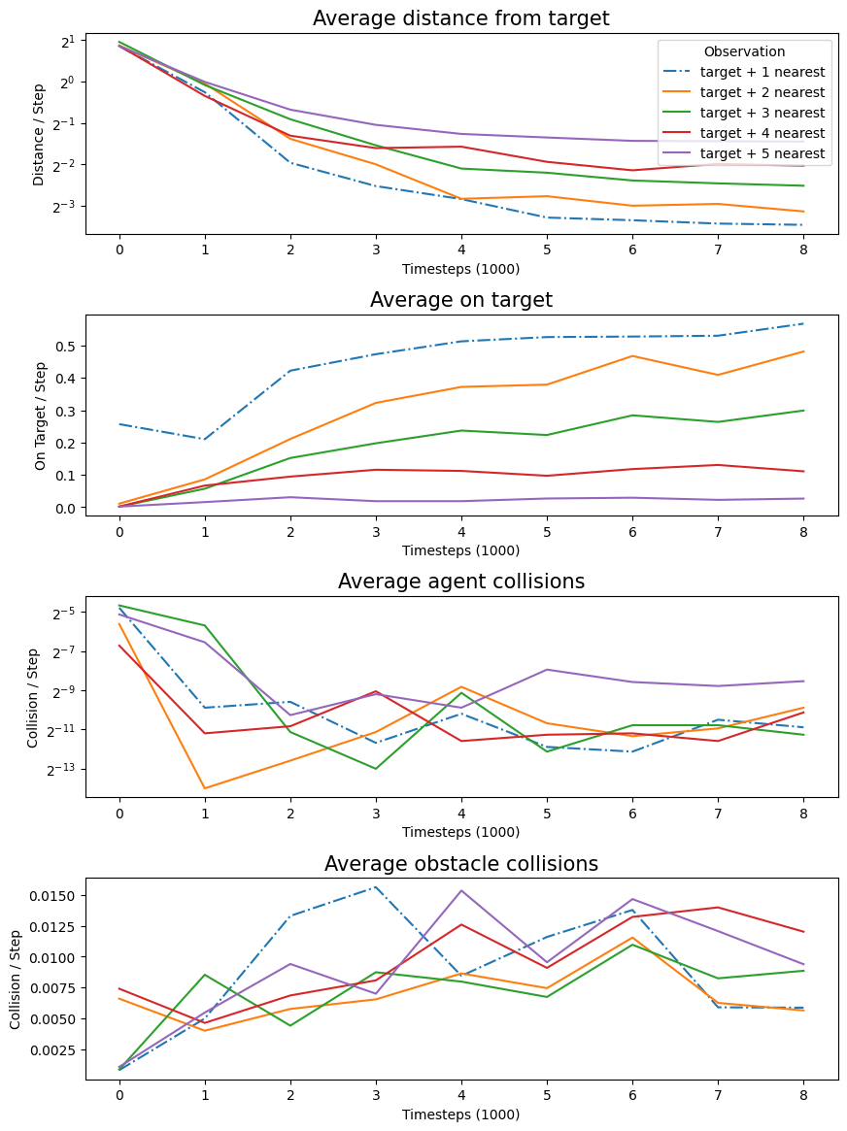
Phase 2 Results (2/4)
Observation size

Slide 15
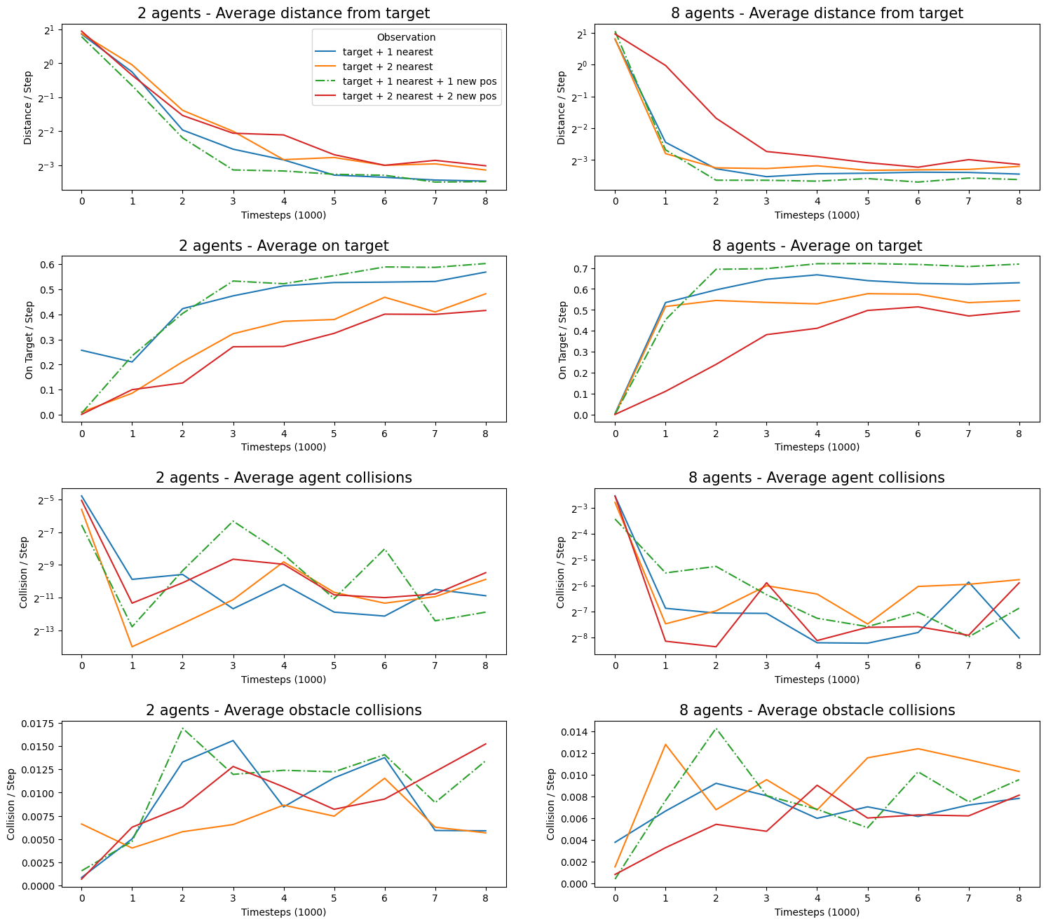
Phase 2 Results (3/4)
Next position of nearby Agent

Slide 16
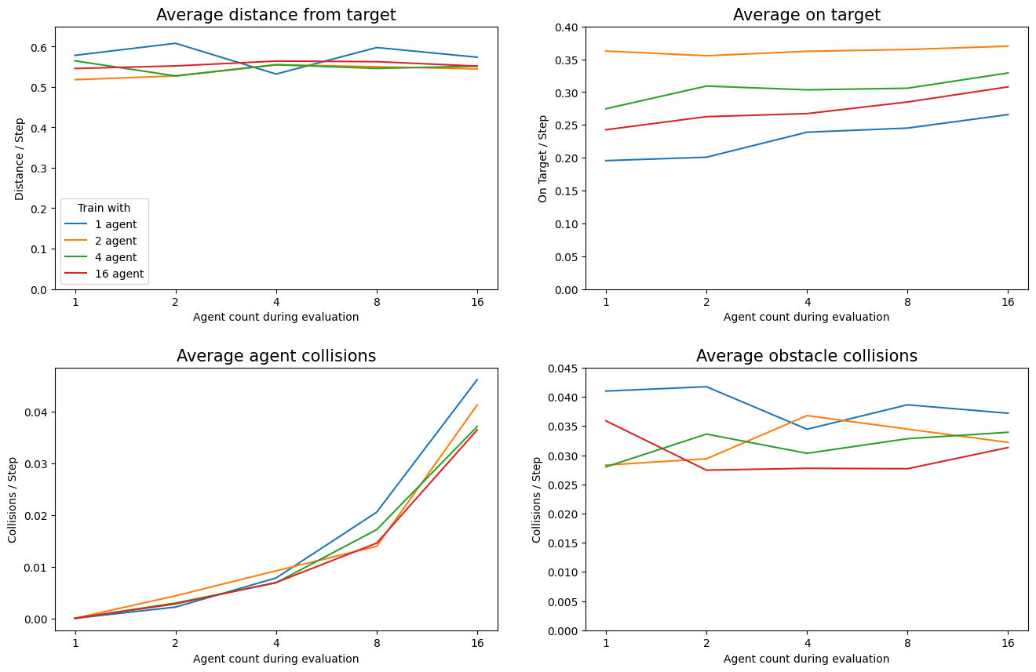
Phase 2 Results (4/4)
Agent count

Slide 17
Agent examples
4 Agents
Trained with 2
8 Agents
Trained with 2
8 Agents
Trained with 16

Slide 18
Conclusion and Further Work
Conclusion
Use logarithm of distance
Can create observations that make the model usable in different environments
Large neural networks not needed for simple environments
PPO can get stuck it local optima very easily
Further Work
Trying out different policies
Neuroevolution

Slide 19
Thank You for Your attention!
Gergely Magyar
dexfd3@inf.elte.hu

